Slide 1
Financial Risk Management
Team Assignment 1
Team 4: Jiani Zhou, Howard Geeng, Xiaoyang Li, Devet Valecha, Jiameng Ma

Slide 2
Part I (Q1)
After analyzing the log returns, our estimation of the 1-day 95% VaR is -0.010575, meaning that 5% of future outcomes will be lower than -0.010575.
Our estimated ES is -0.013315, meaning that if VaR happens, the expected outcome will be -0.013315.
Given the mean = 0.000213, and sd = 0.006558, those results of VaR and ES are reasonable.

Slide 3
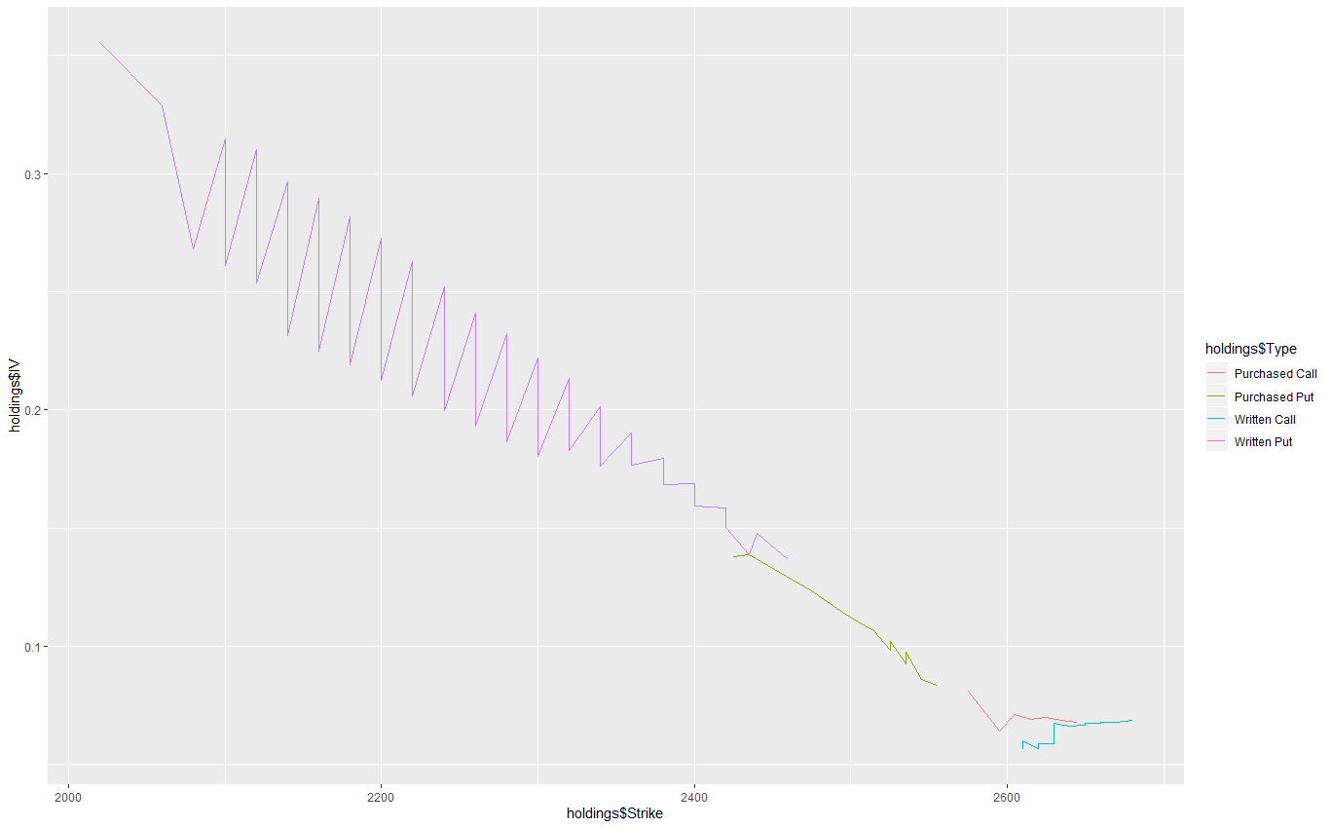
Part I (Q2)
As we can see from the plot, put and call options react quite differently with a change in the implied volatility.
While in put options, there is a volatility skew -- a higher implied volatility seems to correlate with a lower strike price; in call options, the correlation is low.

Slide 4
Part I (Q3)
Given that everything else remains unchanged, when the implied volatility increase by 50%, 100%, 200% and 300%, the value of the fund’s investment decreases by 11.7%, 33.3%, 93.5%, and 164.5%.
To reduce the value of the fund by 50%, the implied volatility need to rise by 130.7%.
This type of increase could happen if a great recession or uncertainty is happening to the whole economy, e.g. the current market situation with effects of the COVID-19. Besides the implied volatility of options, we could also take factors, such as time to expiration and changes in interest rates, into consideration.

Slide 5

Part II (Q4, Q5, Q6)
Basd on the daily log return series of the data:
Q4: Using Jarque-Bera test for normality, we ended up reject normality. The unconditional distribution is not normal.
Q5: The autocorrelation coefficients of |logret| are positive. Thus, there is a strong evidence of volatility clustering.
Q6: The VaR and ES are -0.008308 and -0.012101 for student t distribution at the 95% level, respectively.

